Slide 1
Reproducible Clinical Data Analysis with R and RStudio
Session 3
Exploring Data
April 2 and 3, 2018
Notes:
Who has signed up for DataCamp?
What classes have you looked at? Impressions?
As I had mentioned before, a main goal of this course is for participants to become comfortable using outside resources for just-in-time learning of the skills necessary to accomplish a specific task. From here on out, I’ll start pointing out resources to learn more. One caveat is that often times, these resources aren’t focused on clinical data analysis but on data analysis in general. Sometimes tutorials will go on about things that you don’t care about, like programming or creating web apps. In those cases, don’t get scared but instead feel free to skip the parts that don’t seem applicable or alternatively, work through them anyways, because you might learn something interested along the way.

Slide 2
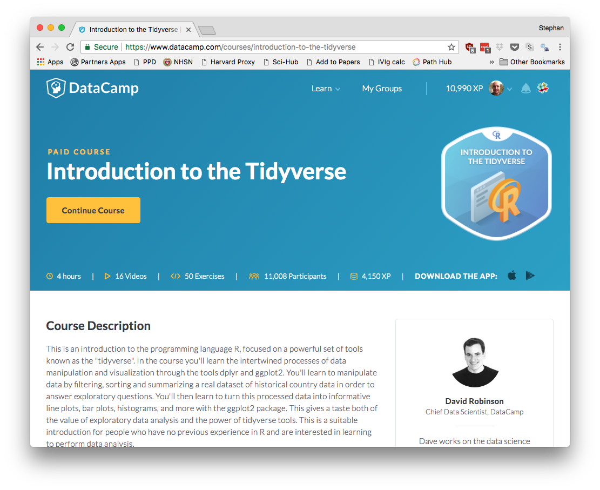
Notes:
Here’s one course that I would recommend to anyone to review and deepen the material we’re covering today. Intro to the tidyverse covers data wrangling, data visualization, and grouping and summarizing. It’s taught by David Robinson who is a thought leader in data science and a great educator.

Slide 3
Introduction | Early: 3/27, 4 PM Late: 3/27, 5:30 PM
Getting Data | Early: 3/28, 4 PM Late: 3/28, 5:30 PM
Exploring Data | Early: 4/3, 4 PM Late: 4/2, 5:30 PM
Reproducible Reports | Early: 4/5, 4 PM Late: 4/5, 5:30 PM
Course Project Presentations | TBA
Notes:
Course Project – please let me know by email or in person what you are thinking about, and we can set up a one-on-one meeting to discuss specifics.

Slide 4
Visualizing Data

Slide 5
Your Turn #1
How do you think the ESR results are distributed?
Discuss with your group.

Slide 6
Notes:
You might have expected that it’s normal or bimodal (with normal and abnormal values). Instead there’s a mode close to zero and a long tail on the right, representing all the abnormal values.
This is not at all clear from looking at a table with almost 50,000 rows.
Being able to visualize data quickly is critical for understanding.
Delete from PDF deck

Slide 7
A grammar of graphics for data visualization
library(tidyverse)
Notes:
We’ll be using the ggplot2 package for creating graphics. Ggplot2 is part of the tidyverse so you all should have it installed.
The idea behind ggplot2 is that you can build any type of graph by specifying the data, a function that specifies the type of graph, and a mapping that describes how the data should be represented as visual marks on that graph.
So there should be a consistent way, or a grammar, to construct any type of graph. The huge advantage of ggplot2 over other graphics packages for R is this consistent grammar, which makes it easy to try out a bunch of different ways to display your data without having to change much code.

Slide 8
ggplot()
initialize a plot
with ggplot()
+ sign
(at end of line)
data frame
ggplot(data = esr) +
geom_histogram(mapping = aes(x = Result))
mappings inside
aes() function
type of graph
“aesthetic” mapping
Notes:
Here is how you use ggplot.
You can see that we give it a data frame, in this case, our ESR data
We specify the type of graph, or “geom”, in this case, a histogram
And we specify an aesthetic mapping, in this case, saying that we want the variable “Result” which as you remember contains results of ESR testing values, on the x axis.
A few more details to note: you always start a plot with the ggplot() function
To connect this to the geom function you actually use a ‘+’ sign which should be put at the end of the line
And the mappings need to go into the aes() function

Slide 9
To make any kind of graph:
1. Pick a “tidy”
data frame
ggplot(data = <DATA>) +
<GEOM_FUNCTION>(mapping = aes(<MAPPINGS>))
2. Choose a “geom” function
3. Write aesthetic mappings
Notes:
So let’s break this down into a mental model. Here’s a template for making any kind of graph with ggplot2.
Pick a tidy data frame
Choose a geom function
Write aesthetic mappings

Slide 10
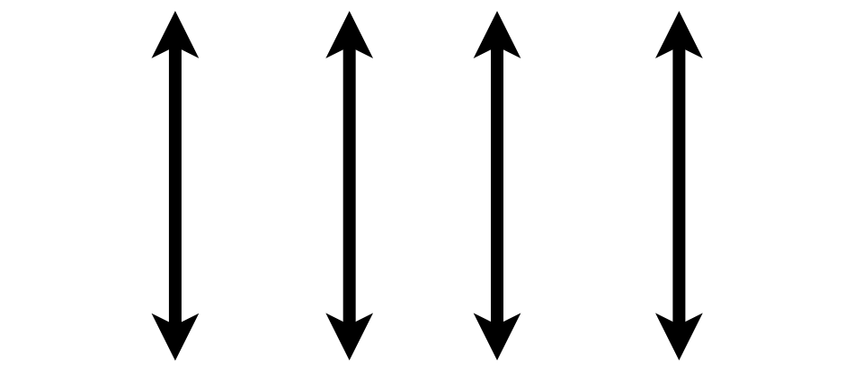

1. Pick a “Tidy” Data Frame
A data set is tidy if:
Each variable is in its own column
Each case is in its own row
Each value is in its own cell
Notes:
This is a good time to introduce the idea of ”tidy” data that also gives the “tidyverse” its name.
Any data set can take on a lot of different shapes. But there is one shape that is best suited for data analysis, and that shape is called ”tidy.” The opposite of “tidy” data is often called “messy” and often times one of the first data analysis tasks is to convert “messy” data into “tidy data.”
The good news is that a lot of times, data that comes from databases is already tidy. That’s also the case for our esr data set.
So here’s a small piece of our esr data, which is tidy. What are the variables?
Ina tidy data set: each variable is in its own column,
Each case is in its own row
Each value is in its own cell

Slide 11
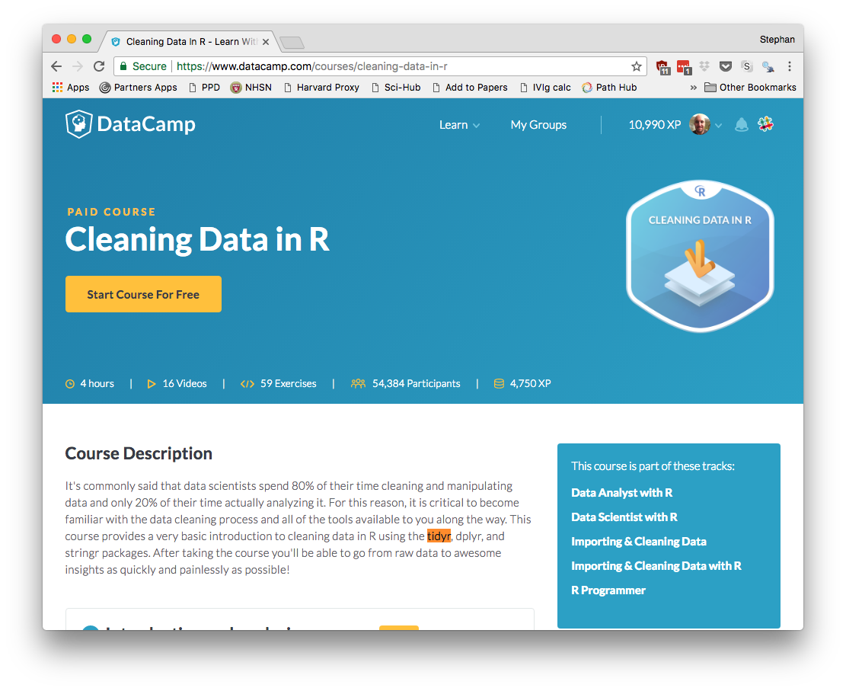
Notes:
In case your data isn’t tidy R has powerful capabilities to clean up a lot of different types of data problems by writing just a few lines of code. We won’t have time to get into it but here is a great DataCamp course on Cleaning Data.

Slide 12
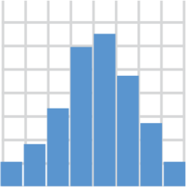
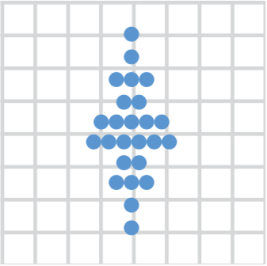
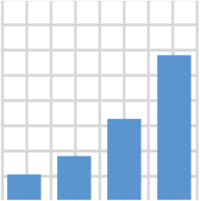

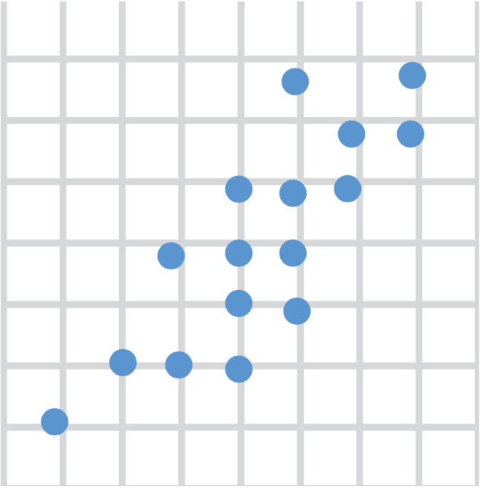
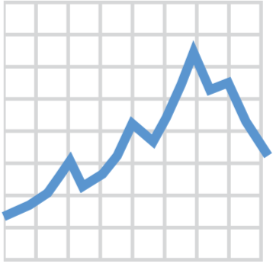
2. Choose a “Geom” Function
geom_histogram()
geom_dotplot()
geom_bar()
geom_boxplot()
geom_point()
geom_line()
Notes:
There are many different ways data can be displayed, and to tell ggplot what type of graph you want you use a geom_ function.
Here are the top 6 most useful geom functions for visualizing clinical data, but there are many more. You can see that they have pretty self-explanatory names: for a histogram, use geom_histogram(), for a line plot, use geom_line().

Slide 13
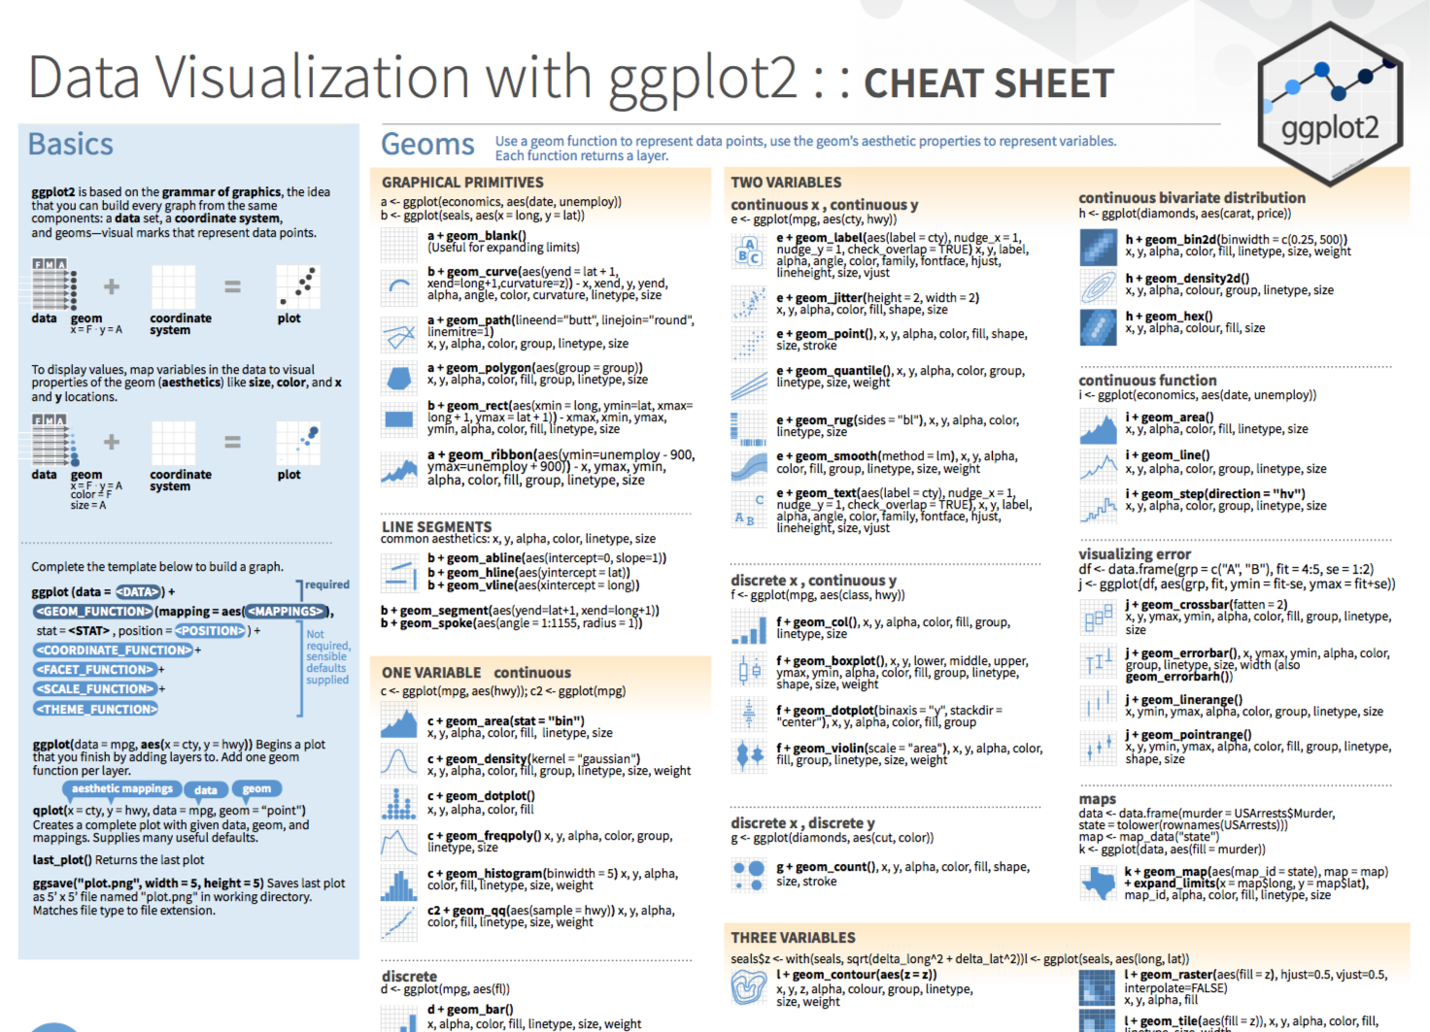
Notes:
The ggplot2 Cheat Sheet (hand out) is great to have on hand as you’re exploring your data with ggplot.

Slide 14
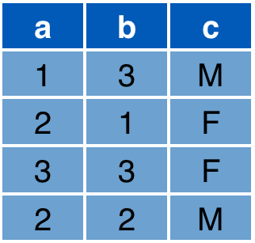

3. Write Aesthetic Mappings
aes(x = a, y = b, color = c)
Data frame
Graph
y
x
Notes:
The final step is to write the aesthetic mappings. The idea behind this is that each graph contains markings whose properties relate to the values of one or more variables of the data set. An aesthetic mapping is simply a list of instructions to the geom function that tell it how the graphical properties should relate to the data.
* For example, in this very simple data set, the x axis value should relate to the a variable (or column)
The y axis value to the b column
And since we’re now out of axes, we can specify that the color should relate to the c column. R figures out a reasonable color scale but you can fine tune this.
As a result, you get the expected graph.

Slide 15
Your Turn #2
Download the files I sent to you by e-mail:
1. 03-exploring-data.Rmd
2. esr_data.csv
Open 03-exploring-data.Rmd in RStudio.
Complete the section “Your Turn #2: Visualizing Data”.
Then, complete the section “Visualizing Data” on the handout.

Slide 16
Isolating Data

Slide 17

A grammar to transform
rectangular data
library(tidyverse)
Notes:
We’ll be using the dplyr package for manipulating data frames. Dplyr should have been installed it as part of the tidyverse.
The idea behind dplyr is that any data analytic task can be performed by a small number of basic tasks, and there should be a consistent way to specify each basic analytic task - a grammar.
In dplyr the grammar is structured a bit differently than ggplot2. It uses verbs such as filter or select. Each verb is a function that takes a data frame, does something with it, and then returns a modified data frame. These verbs can be stringed together to create powerful data analysis pipelines in just a few lines of code.

Slide 18
select()
Extract columns by name.
select(<DATA>, ...)
names of columns to extract
data frame
Notes:
The first dplyr verb we’ll look at is select(). Select extracts columns from a data frame, by name.
Select takes a data frame as its first argument. After that it takes additional arguments that specify the names of the columns that you want to pick.

Slide 19

select()
Extract columns by name.
select(esr, CollAge, Result)
Notes:
For example, this select statement will take esr, and select CollAge and Result. It will then return a new data frame that only has the columns CollAge and Result.
Note: select will not modify the original data frame. If you write the select statement like this it will simply display the result in the console or in you Rmd notebook. If you want to save the modified data frame you need to assign it to an object.

Slide 20
filter()
Extract rows that meet logical criteria.
filter(<DATA>, <CONDITION>)
logical test (return each row for which the test is TRUE)
data frame
Notes:
The second dplyr verb to know about is filter(). Filter extracts rows – not columns – based on logical criteria.
Like select, filter takes a data frame as its first argument. The second argument is a logical test. R then performs that logical test on each row of the dataset and returns all rows in which the logical test was true.

Slide 21
filter()
= sets
== compares
Extract rows that meet logical criteria.
filter(esr, PtSex == "F")
Notes:
To give you an example: the logical test could be that PtSex equals “F”.
This statement will return a data frame that only contains the rows of the data frame in which PtSex equals “F”. So all rows where PtSex is NOT “F” will be thrown out. It’s a POSITIVE filter.
An important thing to realize here is that you don’t have to tell filter to go row by row here. It will know to do this comparison for each row, i.e. 50,000 times.
Also note that double equals operator. Double equals means: compare the left hand side to the right hand side and if it’s the same, then return TRUE. The double equals is called the comparison operator. In contrast, a single equals sign is an operator that sets or assigns the variable on the left hand side to the value on the right hand side; exactly like the assignment operator. One common mistake is to use a single equals instead of double equals.

Slide 22
Logical Tests
x < y | less than
x > y | greater than
x == y | equal to
x <= y | less than or equal to
x >= y | greater than or equal to
x != y | not equal to
is.na(x) | a missing value
Notes:
Here are some important logical operators to know about. They will all come in handy when you’re filtering rows of a data frame.
We’ve already seen the equal to. Note the less than or and greater than operators. These operators also come as “or equal to” versions.
Use != if you want to select rows in which a value is not equal to something else.
Is.na is how you can test for missing values. Often times you want to remove missing values.

Slide 23
arrange()
Order rows from smallest to largest.
arrange(<DATA>, ...)
names of columns to order by (additional columns = tie breakers)
data frame
Notes:
arrange() is a dplyr verb that can be used to order rows, by default from smallest to largest.
It takes a data frame as its first argument and after that names of columns to order by. If you give arrange more than one column name, then this will be used as a tie breaker for the first column, and so on.

Slide 24
arrange()
descending order: desc(CollAge)
Order rows from smallest to largest.
arrange(esr, CollAge)
Notes:
For example, we can arrange esr by CollAge.
* To arrange in descending order, wrap the column name in the desc() function – for “descending”.

Slide 25
%>%
Notes:
I’ll now introduce an powerful concept in the tidyverse – the pipe operator, which is typed as percent-greater than-percent.
I’ll first show you exactly what it does, and then why it’s so useful for data analysis.

Slide 26
The Pipe Operator %>%
%>%
esr filter( , PtSex == "F")
Passes the object on the left as first argument to the function on the right.
filter(esr, PtSex == "F")
esr %>% filter(PtSex == "F")
Notes:
The pipe operator passes the result of the expression on its left side as the first argument of the function on the right side.
So these two lines of code are equivalent. In both cases esr is passed on as the first argument to filter.

Slide 27
”then”
esr %>%
select(CollAge, PtSex, Result) %>%
filter(PtSex == "F") %>%
arrange(Result)
Notes:
So here’s why this is so useful.
Tidy functions (such select, filter, arrange, and others we’ll see later) always have as first argument a data frame, and they always return a data frame.
This makes it possible to create pipelines in which a data frame object is handed from one tidy function to the next
* The pipe operator is usually pronounced “then”.
For example, here we start with esr, then select these 3 columns, then filter for female patient sex, then arrange by “Result”.
You’ll get a pipeline of data analysis steps which are concise, flexible, and also fairly human readable, even to a non-programmer. This is powerful because you’ll be able to explain to someone who isn’t a programmer or statistician (this may include yourself 6 months down the road or your attending who doesn’t know R) exactly what you did.

Slide 28
Your Turn #3
Return to 03-exploring-data.Rmd.
Complete the section “Your Turn #3: Isolating Data”.
Then, complete the section “Isolating Data” on the handout.

Slide 29
Augmenting Data

Slide 30
mutate()
Create new columns.
mutate(<DATA>, ...)
name-value expressions
column_name = value
data frame
Notes:
Mutate is a dplyr verb that you can use to add a new column or variable to the data set.
Like all tidy functions, it takes a data frame as its first argument. After that, you tell it what to name the new column and what should be in it. This is done using name-value expressions.

Slide 31
mutate()
Create new columns.
mutate(esr,
BirthYr = 2017 - CollAge)
Notes:
For example, here I create a new column named BirthYr in which each value should be equal to 2017 - CollAge.
Note that it takes just a single command to perform calculations on almost 50,000 rows.

Slide 32
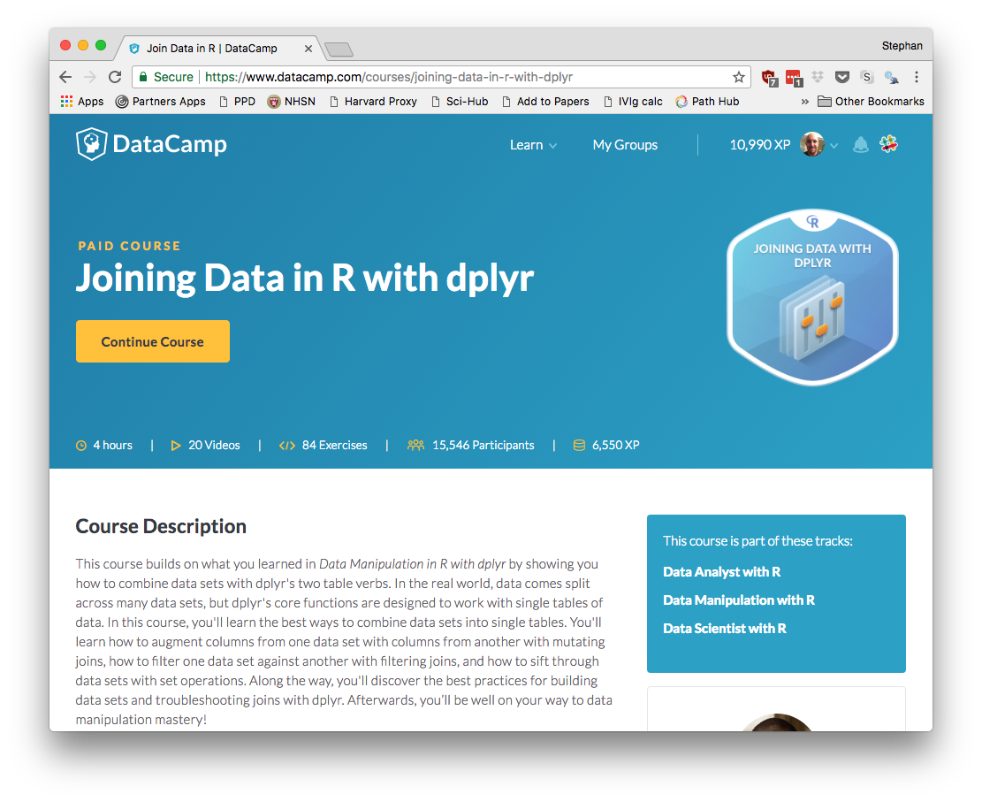

Slide 33
Grouping and Summarizing Data

Slide 34
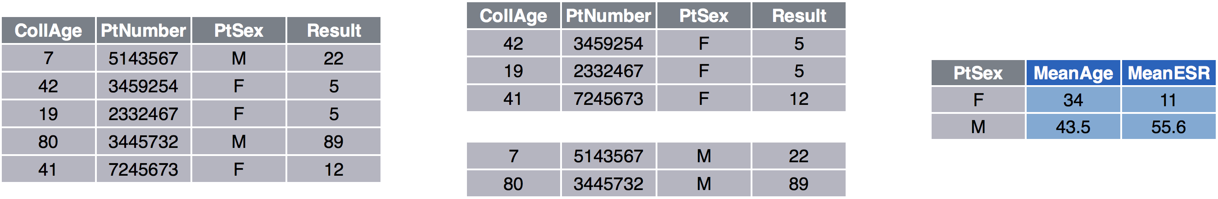
esr %>%
group_by(PtSex) %>%
summarize(MeanAge = mean(CollAge),
MeanESR = mean(Result))
Notes:
The final two dplyr verbs I want to introduce today are group_by and summarize. You’ll usually want to use them together. Let’s look at an example.
Here we pass esr to group_by and tell it to group by PtSex, which is a categorial variable. Group_by breaks up the data frame into pieces.
The summarize function looks a lot like the mutate function in that it takes key-value pairs to create but there are important differences.
It creates an entirely new data frame that

Slide 35
Summary (Aggregate) Functions
n() | total count
n_distinct(x) | count of distinct values
mean(x) | mean
median(x) | median
sum(x) | sum
sd(x) | standard deviation
Set argument na.rm = TRUE to ignore missing values (NA)

Slide 36
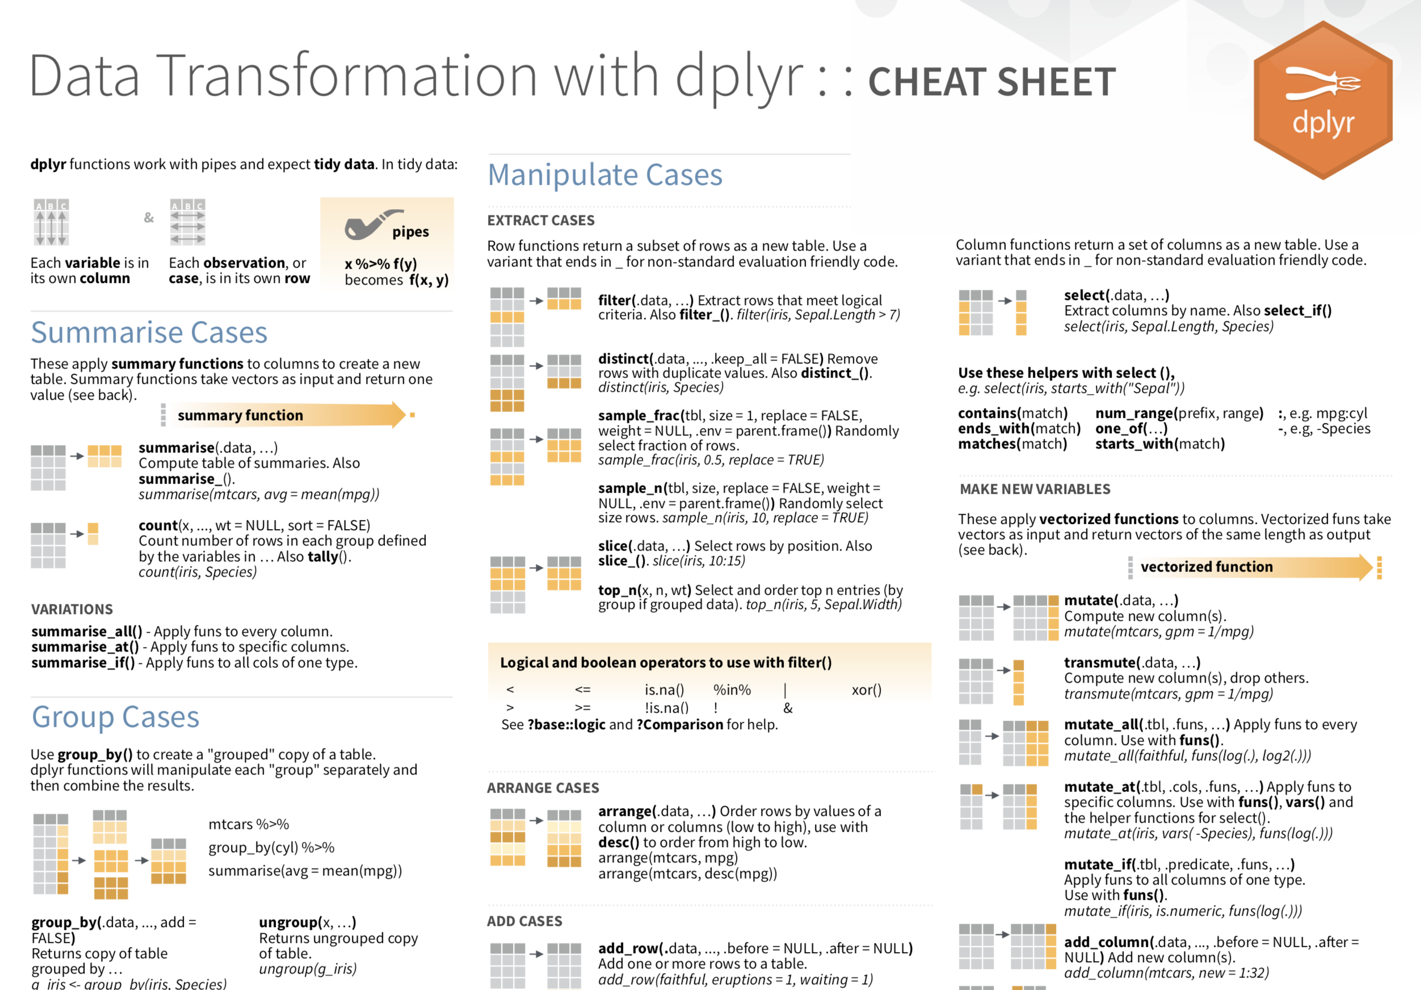

Slide 37
Your Turn #4
Return to 03-exploring-data.Rmd.
Complete the section “Your Turn #4: Grouping and Summarizing Data”.
Then, complete the section “Grouping and Summarizing Data” on the handout.
Notes:
Load est_data

Slide 38
Notes for next time
Notes:
- Make the point that n() does not take and argument

